Slide 1
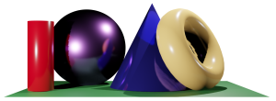
Math 035 General View of Mathematics
Hongda Qiu
Department of Mathematics
hqiu@psu.edu
402 McAllister

Slide 2
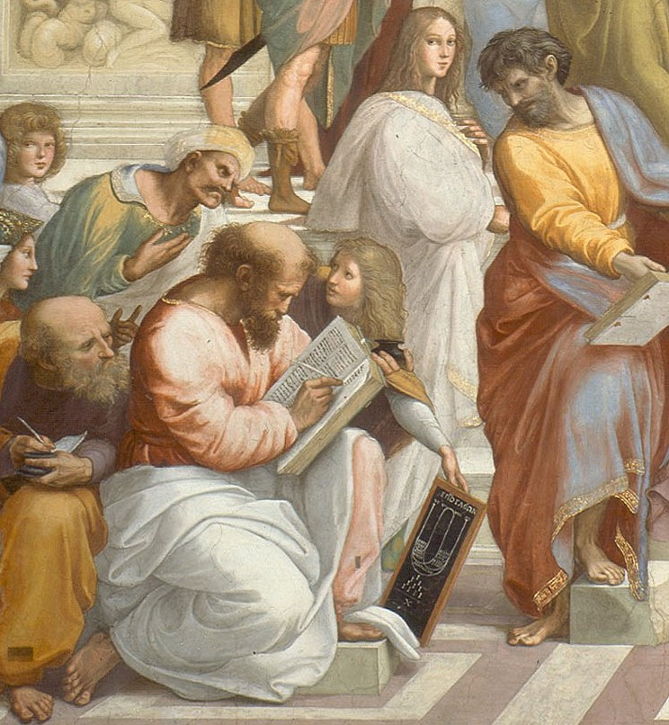
Introduction to ancient mathematics
The academic community of Greek​
Philosophy​
Physics​
Mysticism​
The position of mathematics in Greek academics

Slide 3
Introduction to ancient mathematics
The branches of ancient mathematics
Number Theory
Geometry
Algebra

Slide 4
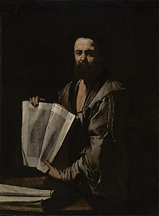
Euler and elementary geometry
The “Elements”

Slide 5
Euler and elementary geometry
Euler’s definitions on geometry
Points, lines, areas…
Squares, circles, triangles…

Slide 6
Euler and elementary geometry
Euler’s postulates of geometry (Axioms of plane geometry)
To draw a straight line from any point to any point
To produce a finite straight line continuously in a straight line
To describe a circle with any centre and distance
That all right angles are equal to one another
That, if a straight line falling on two straight lines make the interior angles on the same side less than two right angles, the two straight lines, if produced indefinitely, meet on that side on which are the angles less than the two right angles

Slide 7
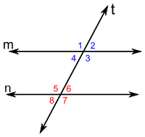
Euler and elementary geometry
Euler’s postulates of geometry
1st: To draw a straight line from any point to any point^{[l]}
2nd: To produce a finite straight line continuously in a straight line
3rd: To describe a circle with any centre and distance
4th: That all right angles are equal to one another
5th: That, if a straight line falling on two straight lines make the interior angles on the same side less than two right angles, the two straight lines, if produced indefinitely, meet on that side on which are the angles less than the two right angles
Ps: anle 1=angle 5 = angle 3= angle 5= angle 7

Slide 8

Euler and elementary geometry
Assumption: Euler’s Fifth Postulate
Statement: The sum of internal angles of a triangle is 180.
Proof:…
Hint: “get” a pair of parallel lines in the picture first.

Slide 9
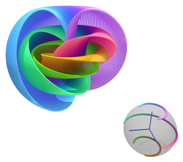
Euler and elementary geometry
Side notes: Axiom vs Assumptions in Theorem
Connection to syllergism in philosophy
Axiom--general assumption
Theorem--specifc assumption+statement
Proof--derivation, plays a key role

