Slide 1

Math 035 General View of Mathematics
Hongda Qiu
Department of Mathematics
hqiu@psu.edu
402 McAllister

Slide 2
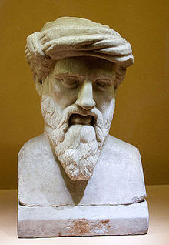
Pythagorean Theorem
Pythagoras
Pythagoreanism and The Pythagorean School
Pythagoras (around 500 BC)

Slide 3
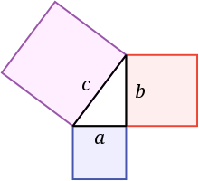

Pythagorean Theorem
$$a^{2}+b^{2}=c^{2}$$
Footnote: No one knows when and where this theorem was discovered first…

Slide 4

Proof of Pythagorean Theorem
$$a^{2}+b^{2}=c^{2}$$

Slide 5
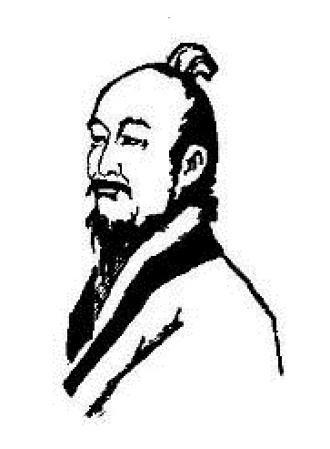
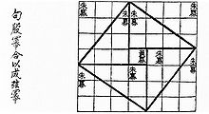
A Proof from Ancient Chinese Mathematician
The String Graph
Section “Gougu Theorem”, Notes of “Zhou Bi”
Zhao, Shuang (around 300 AC)

Slide 6
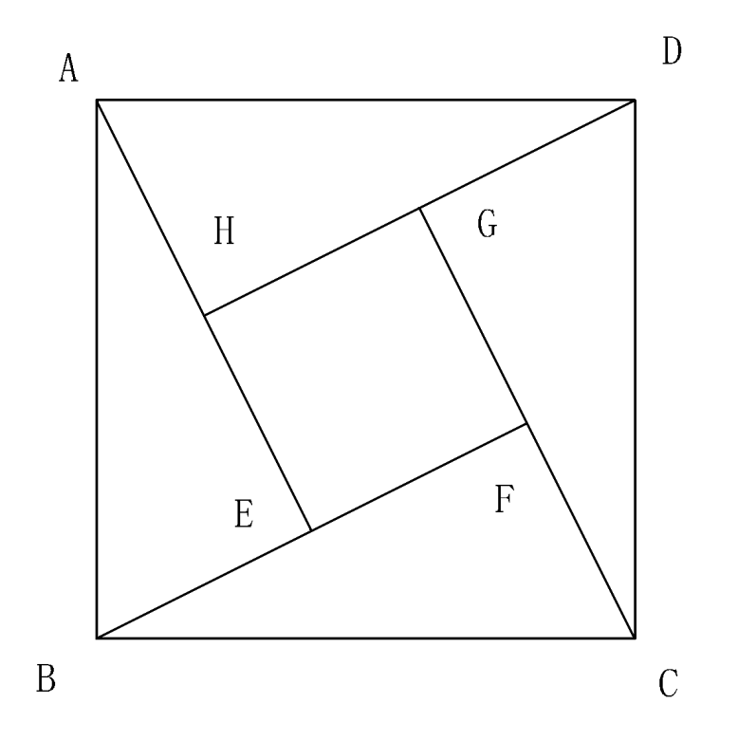
A Proof from Ancient Chinese Mathematician
The String Graph
Section “Gougu Theorem”, Notes of “Zhou Bi”
Zhao, Shuang (around 300 AC)

Slide 7
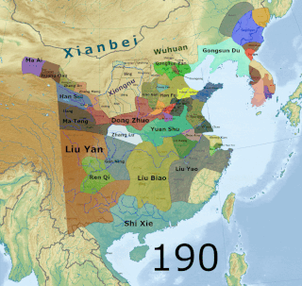
A Proof from Ancient Chinese Mathematician
The “Three Kingdoms” period (220-280 AC)
Zhao, Shuang (around 300 AC)

Slide 8
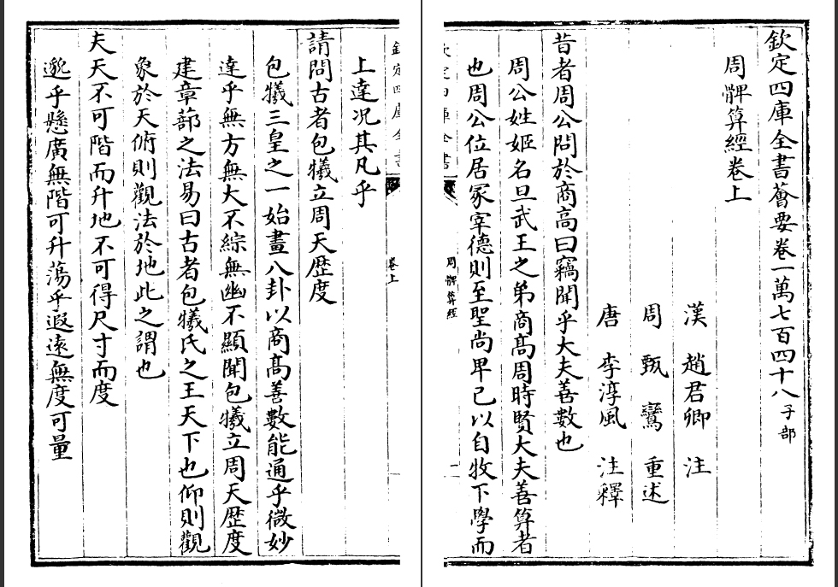
A Proof from Ancient Chinese Mathematician
A copy of “Zhou Bi” published on 1783
Zhao, Shuang (around 300 AC)

Slide 9
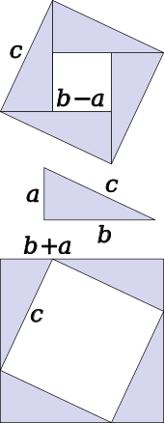
Proofs of Pythagorean Theorem

Slide 10
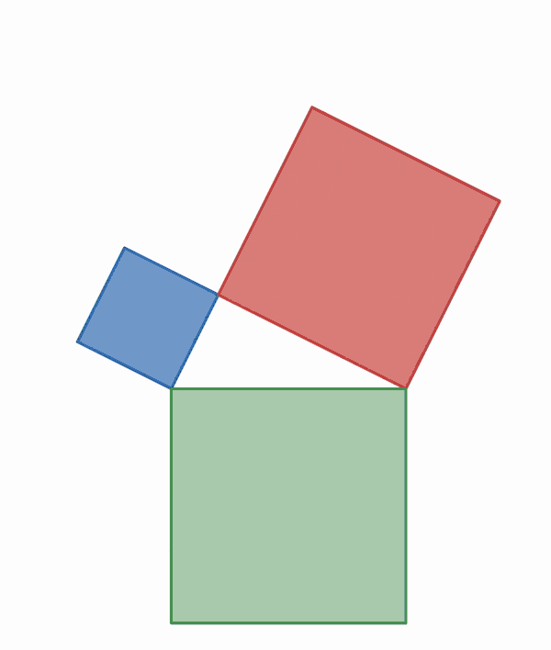
Proofs of Pythagorean Theorem

Slide 11
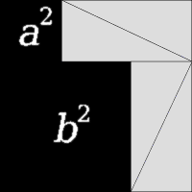
Proofs of Pythagorean Theorem

Slide 12
Consequences of Pythagorem Theorem
Pythagorem Triples
(3, 4, 5), (5, 12, 13), (7, 24, 25), (8, 15, 17), (9, 40, 41),
(11, 60, 61), (12, 35, 37), (13, 84, 85), (16, 63, 65), (20, 21, 29),
(28, 45, 53), (33, 56, 65), (36, 77, 85), (39, 80, 89), (48, 55, 73),
(65, 72, 97), ……

Slide 13
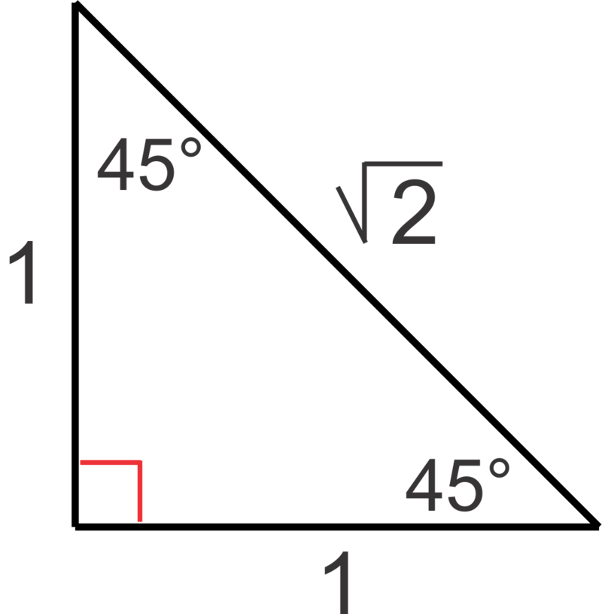
Consequences of Pythagorem Theorem
The First Mathematical Crisis
“…but $\sqrt{2}=?$”

Slide 14
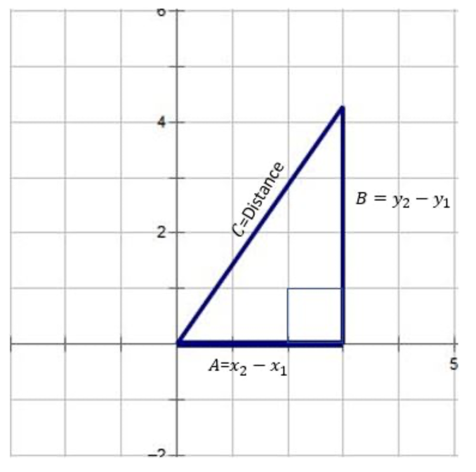
Consequences of Pythagorem Theorem
Euclidean Distance

Slide 15
Consequences of Pythagorem Theorem
Euclidean Distance
The whole direction of geometry was changed
“Without Euclidean distance”: ancient greeks were still fixing on technical staffs such as Menelaus theorem, Ceva theorem…
“With Euclidean distance”: everything is computable. Modern geometry…

