Slide 1
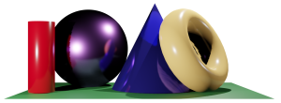
Math 035 General View of Mathematics
Hongda Qiu
Department of Mathematics
hqiu@psu.edu
402 McAllister

Slide 2
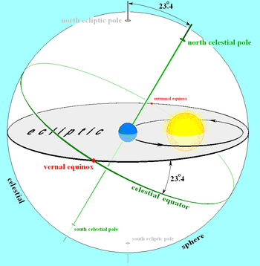
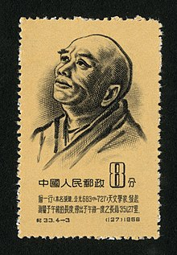

More about Ancient China Mathematics
Obliquity of the Ecliptic, Zhang Sui (Yixing the Monk) (721)
$23.4$ the angle between the plane of equator (ecliptic) and the plane of the solar orbit

Slide 3
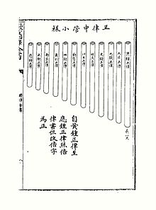
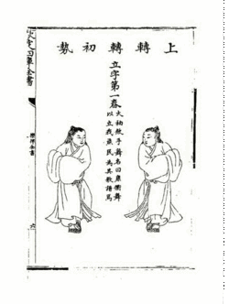
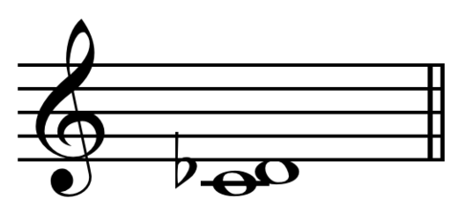

More about Ancient China Mathematics
12 equal temperament, Zhu Zaiyu (1584)
$\sqrt[12]{2}$ --ratio of frequencies between every pair of adjacent notes
Shorter string/higher frequency as the note increases

Slide 4
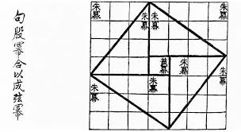
Quick Notes about Ancient China Mathematics
Contribution
Comments of Ancient China Mathematics
Factors
Blockings

Slide 5
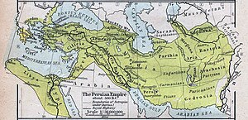
Introduction to Ancient Mathematics
Ancient Persian Society
Persian Academics

Slide 6

Introduction to Ancient Mathematics
Libraries in Persian

Slide 7
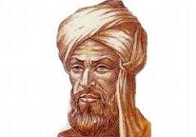
Al-Khwarizmi محمد بن موسى الخوارزمي
Life (780 to Middle 800)

Slide 8
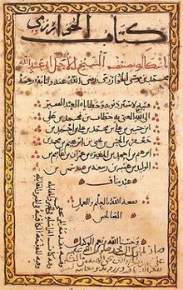
Al-Khwarizmi
The Algebra
“Algorithm” الگوریتم and “algebra” جبر

Slide 9
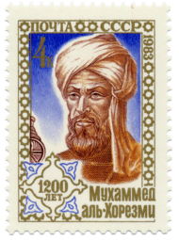
Al-Khwarizmi
Equations
Linear
Quadratic
Trigonometry
Table of sin and cosine

