Slide 1
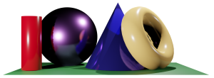
Math 035 General View of Mathematics
Hongda Qiu
Department of Mathematics
hqiu@psu.edu
402 McAllister

Slide 2
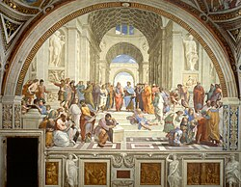
Introduction to Modern Math
Inspiration of European Math Research
Society
The Wave of Retranslation from Arabic (12th century) and Renaissance (14th -16th century)
Age of Enlightenment, 17th century

Slide 3
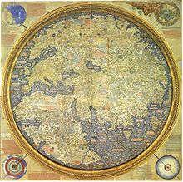
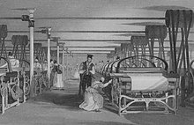
Introduction to Modern Math
Inspiration of European Math Research
Demands in Technology and Astronomy
Age f Discovery, 15th century
Industrial Revolution, 18th century

Slide 4

Introduction to Modern Math
Branches
Algebra
Calculus and Analysis
Geometry
Topology
Discrete Math
Mathematical Physics
Applied Math

Slide 5
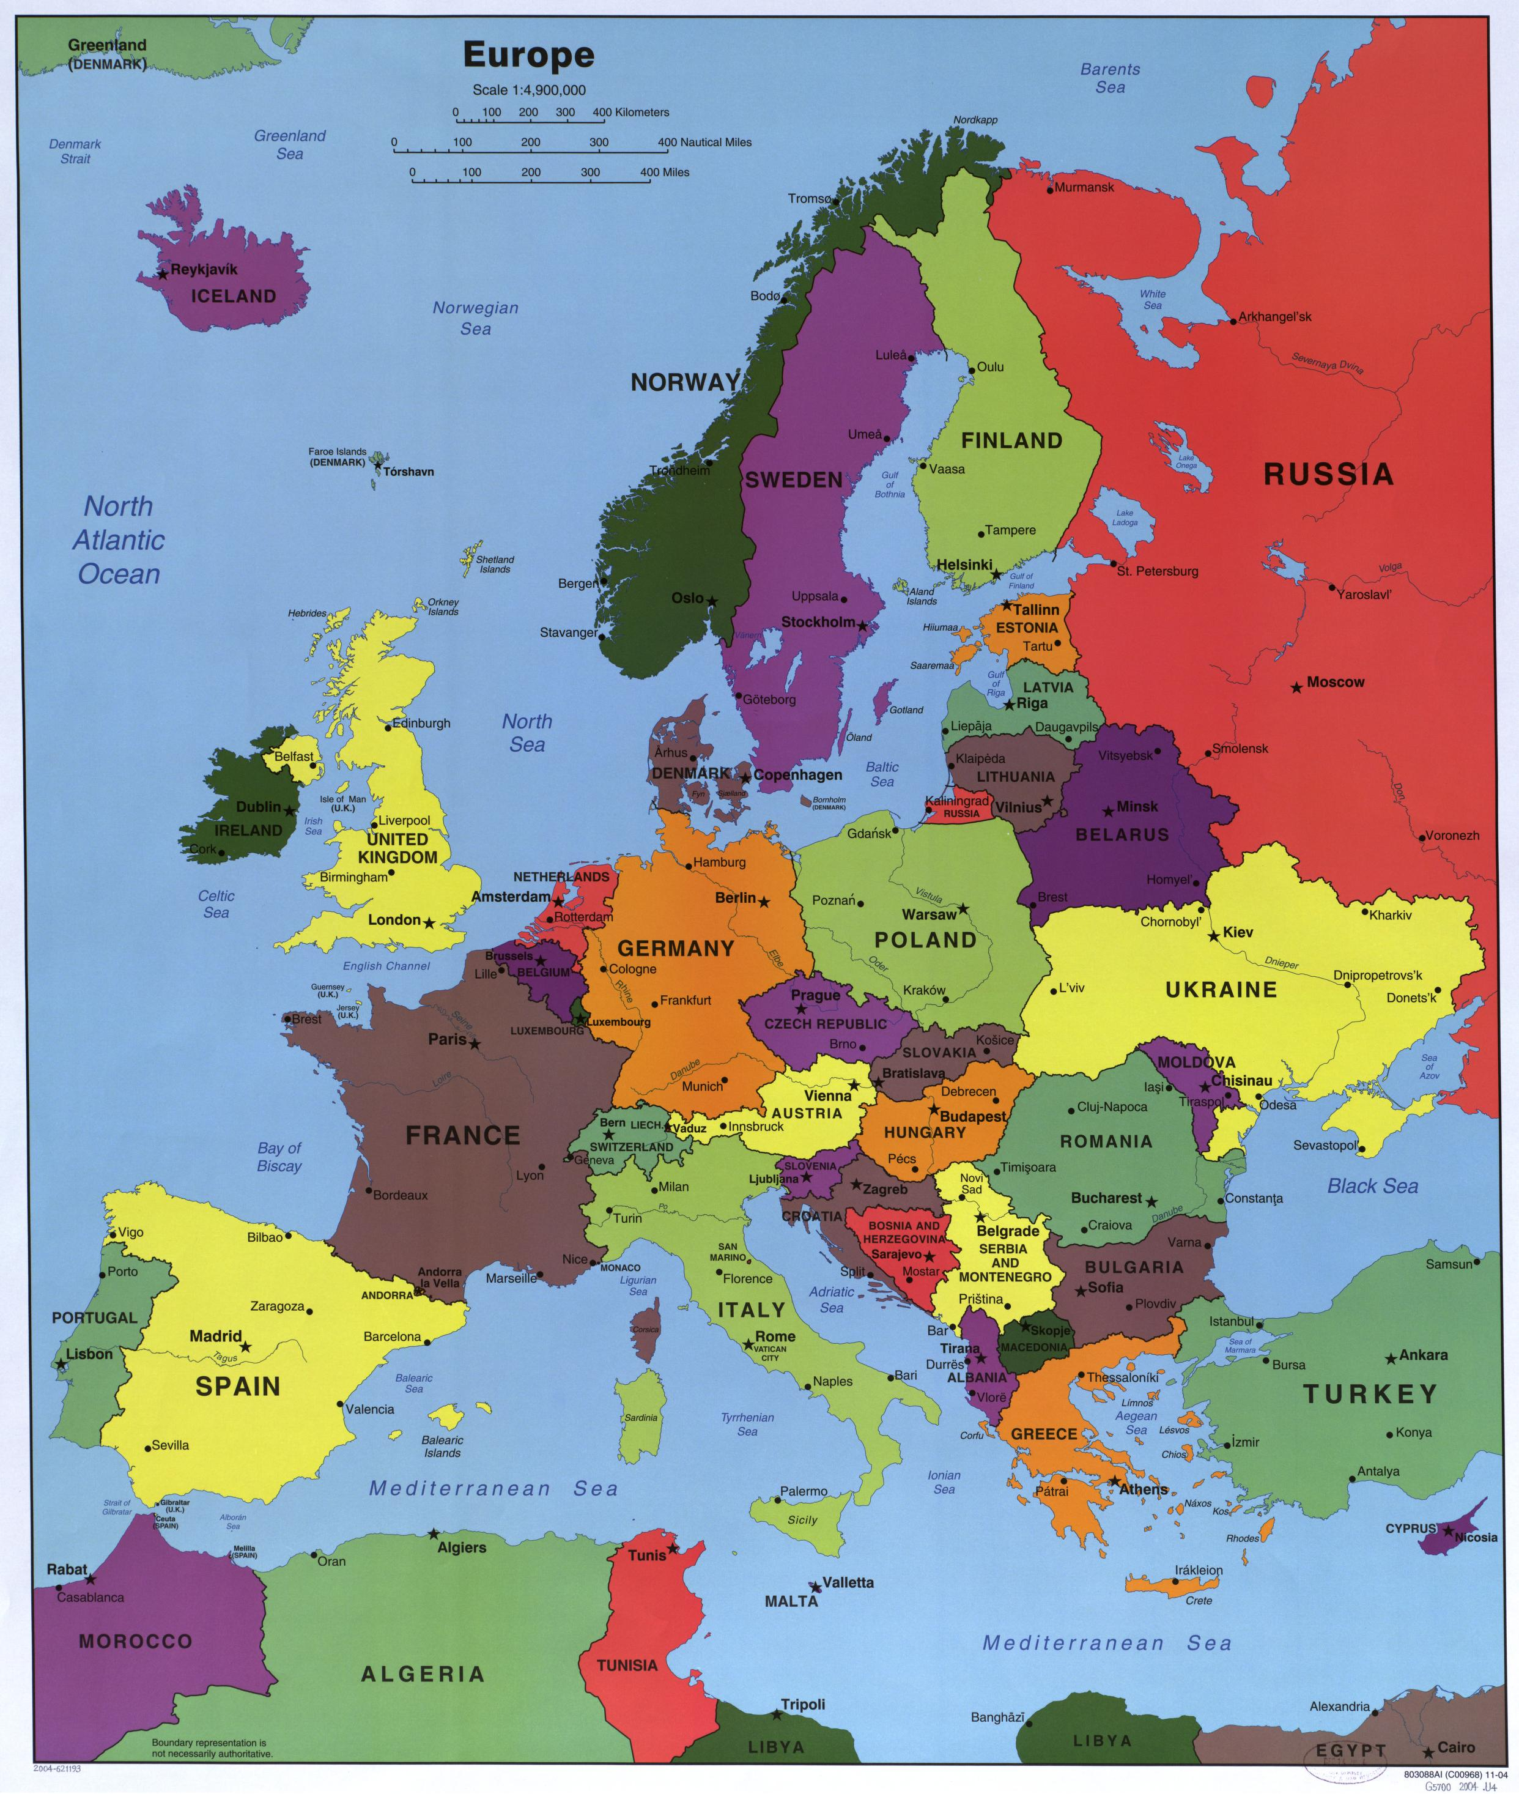
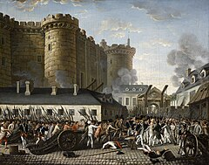
Introduction to French Mathematics
The geography and society of France
Position
Algricuture
Centers of the Enlightenment
The French Revolution

Slide 6
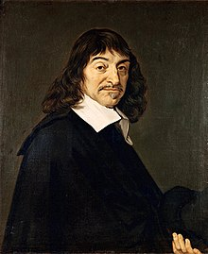
René Descartes (Renatus Cartesius)
Life (1596-1650)
Early Life
Education, Societas Iesu, 1604-1616
Military Service in Netherland, 1618-1621
Math Education

Slide 7
René Descartes (Renatus Cartesius)
Works on Philosophy, 1622-1639
Meditationes de prima philosophia, 1641
Cogito ergo sum
Skepticism
Late life in Sweden

Slide 8
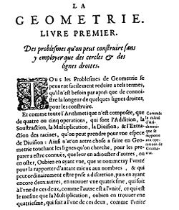
René Descartes (Renatus Cartesius)
La Géométrie, 1637
The impact on Mathematics, 1740-
Prohibiting and Releasing of Descartes’s works

Slide 9
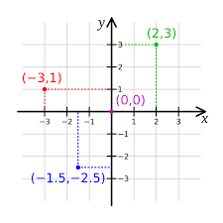
René Descartes (Renatus Cartesius)
Idea of Coordinates
Analytical Geometry

Slide 10
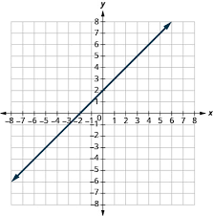
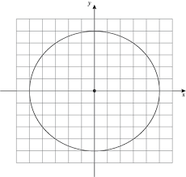
Redescription of Classical Geometry
Equations
Points
Linear Equation—Lines
Circles

Slide 11
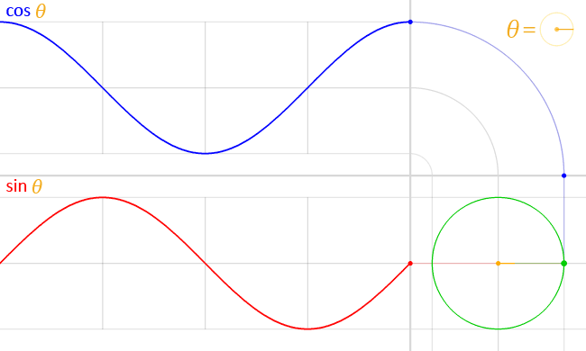
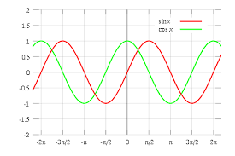
Redescription of Classical Geometry
Trigonometric Functions

Slide 12
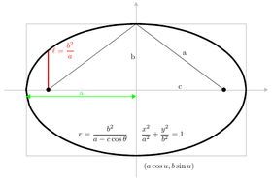
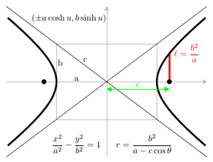
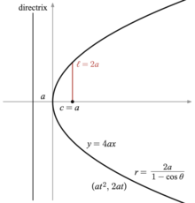
Redescription of Classical Geometry
Conic Curves
Ellipse
Hyperbola
Parabola

