Slide 1

Math 035 General View of Mathematics
Hongda Qiu
Department of Mathematics
hqiu@psu.edu
402 McAllister

Slide 2
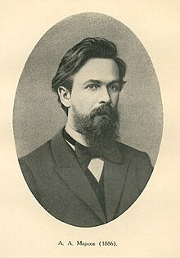
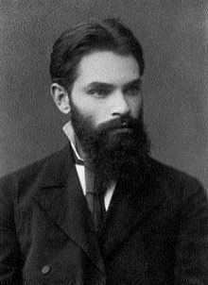
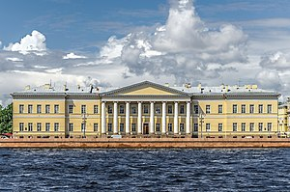
Introduction to European Mathematics
Remarks on Russian Imperial Math
Andrey Markov
Aleksandr Lyapunov

Slide 3
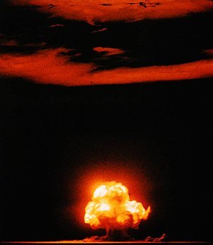
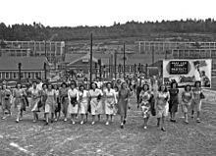
Introduction to Modern Mathematics
The significant change of scientific research
  A flash-back: scientific research before 20 century
    “Workshop”
  “Big Science” and Manufacturing Science
    Manhattan Project
    Space Engineering
    Military
    Automobile
  The role of administrative management

Slide 4
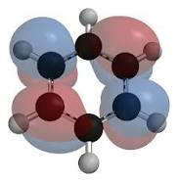
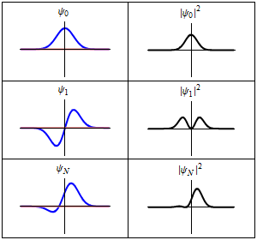
Introduction to Modern Mathematics
The significant change of scientific research
  New branches of mathematics
    Scientific Computing
    Mathematical Physics
    Data Science

Slide 5
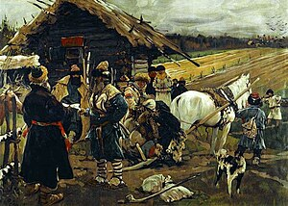
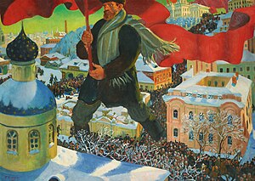
Introduction to Modern Mathematics
The suppression in Russian Empire and the resistance of ordinary people
  Serfdom in Russian Empire
  The Industrialization of Russia and the rise of great cities
    Resource of labors
    Life of workers

Slide 6
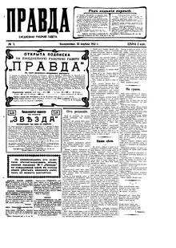
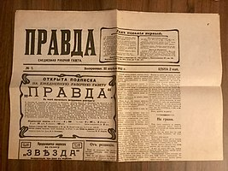

Introduction to Modern Mathematics
The suppression in Russian Empire and the resistance of ordinary people
  Life of workers in Russia cities and the awakening of the whole worker’s class
  The political arguments of the working class
    Working-hours and public welfare
    Peace
      World War I
    Equality
      Education
      Opportunity of laboring and employment
Newspaper published by working class political forces

Slide 7
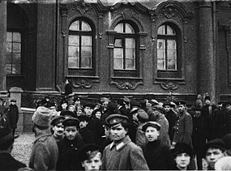
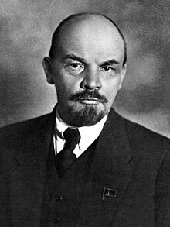
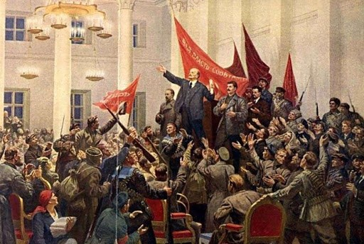
Introduction to Modern Mathematics
October Revolution, 1917
  Early political activities of the working class and the rise of the Bolsheviks
  February Revolution
    The Russian Provisional Government
  Strikings and protests against the War

Slide 8
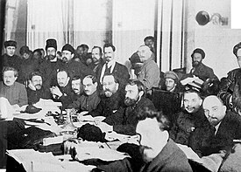
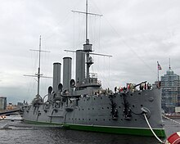
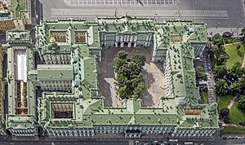
Introduction to Modern Mathematics
October Revolution, 1917
  Preparation
    Participance
  The incident of Cruiser Aurora
    The first military attack at the Winter Palace
  Military actions in cities
    Moscow
    Saint Petersburg
    Ural
    Baku
  The result
    The foundation of Soviet Russia and Soviet Union

Slide 9
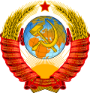
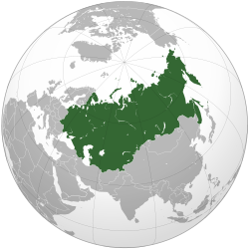


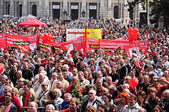
Introduction to Modern Mathematics
Soviet Union
Soviet festivals
  International Women’s day, March 8th
  International Worker’s day, May 1st
Remarks

Slide 10
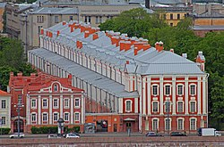
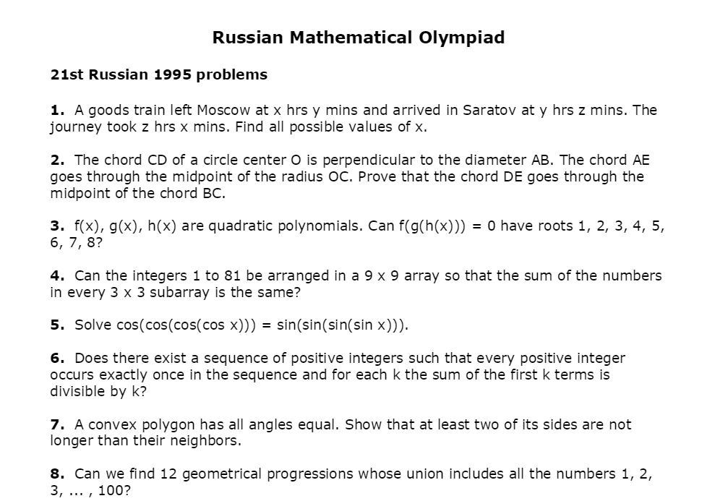
Introduction to Modern Mathematics
The education system of Soviet Union
  Inspiring factors
    Poor literacy ratio
    Lack of resource and poor economy after war
    The strong desire for industrialization
  The centralized and uniform system
  10-year compulsory education
  Undergraduate and graduate education
  Special system for talented students
  Competitions in Mathematics, Physics and Chemistry

Slide 11
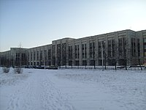
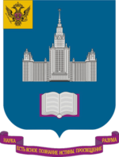

Introduction to Modern Mathematics
Advanced Mathematical education in Soviet Union
  Major in Mathematics and Mechanics

Slide 12
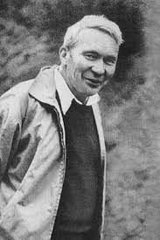
Andrey Kolmogorov
Life (1903-1987)
Early Life

Slide 13
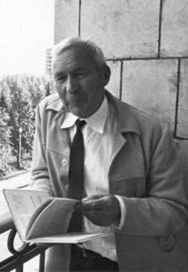
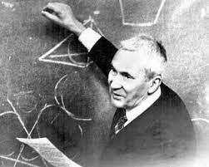
Andrey Kolmogorov
Life (1903-1987)
Early Life
Education Experience
  Moscow State University

Slide 14
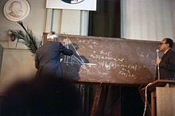
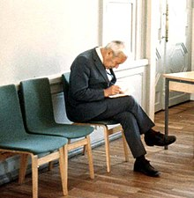
Andrey Kolmogorov
Career at Moscow State University
Research

