Slide 1

Math 035 General View of Mathematics
Hongda Qiu
Department of Mathematics
hqiu@psu.edu
402 McAllister

Slide 2
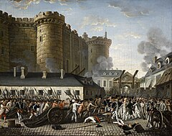
Introduction to French Mathematics
The French Revolution (1789-1799)
Déclaration des Droits de l'Homme et du Citoyen (La Fayette)

Slide 3
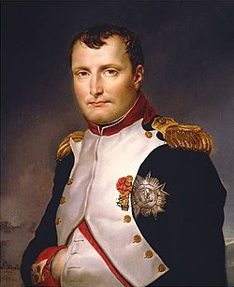

Introduction to French Mathematics
République Française and Empire Français
Napoléon Ier Bonaparte

Slide 4
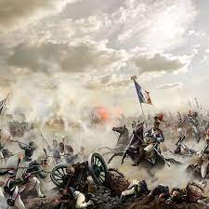


Introduction to French Mathematics
République Française and Empire Français
Napoléon Ier Bonaparte
The rise of French military education system during Napoléon’s sovereignity

Slide 5
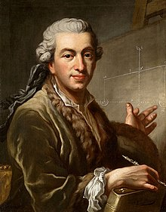
Pierre-Simon Laplace
Life (1749-1827)
Early Life
Education, University of Caen
Early Career
Ecole Militaire, 1769-1776
As a politician
Minister of Interior, during the coup d’état du 18 Brumaire, 1799
Senator, 1799-
As a mathematician and phycist

Slide 6

Pierre-Simon Laplace
Impact on Astronomy and Philosophy
Celestial Mechanics
Stability of Solar System

Slide 7
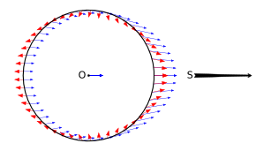
Pierre-Simon Laplace
Impact on Astronomy and Philosophy
Tidal force

Slide 8
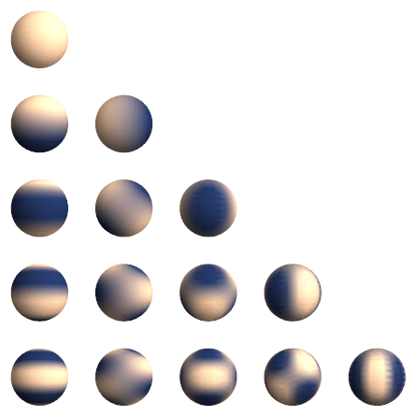
Pierre-Simon Laplace
Impact on Astronomy and Philosophy
Distribution of Gravity

Slide 9
Pierre-Simon Laplace
Impact on Philosophy
Laplace’s Demon: Initial value problem and solution
Mechanics and Determinism

Slide 10
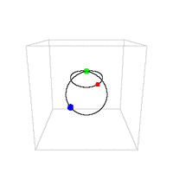
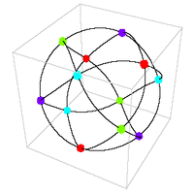
Pierre-Simon Laplace
Impact on Mathematics and Philosophy
Stable problem: ballistics, mechanics on plane…
Unstable problem: multi-body mechanics, mechanics on saddle…

