Slide 1
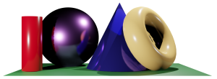
Math 035 General View of Mathematics
Hongda Qiu
Department of Mathematics
hqiu@psu.edu
402 McAllister

Slide 2

Introduction to French Mathematics
A few more notes
The center of math education in Europe
Académie Française

Slide 3
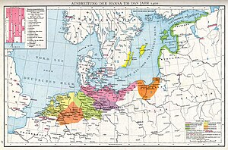


Introduction to German Mathematics
Origin of the German Nationality
Deutsche Hanse
    Commercial Society
The rise and union of German states
  Holy Roman Empire (Heiliges Römisches Reich, Heiliges Römisches Reich deutscher Nation)
  Prussia, Militarism and the earliest Compulsory Education

Slide 4


Introduction to German Mathematics
German Education
    The earliest universities in Human history
      Georg-August-Universität Göttingen, Gottingen, 1734
      Humboldt-Universität zu Berlin, Prussia, 1809

Slide 5
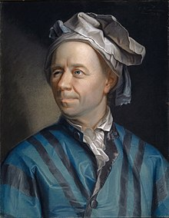
Leonhard Euler
Life (1707-1783)
Early Life, Alte Eidgenossenschaft, Swiss, Heiliges Römisches Reich deutscher Nation
Education and Early Career
  Swiss
  Paris

Slide 6


Leonhard Euler
Career, Saint Petersburg, 1727-1741

Slide 7
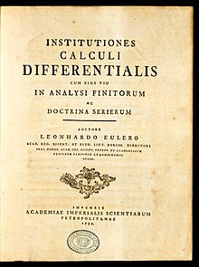
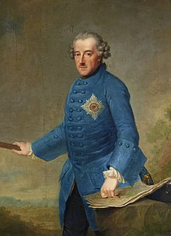
Leonhard Euler
Career, Berlin 1741-1766

Slide 8

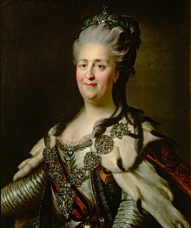
Leonhard Euler
Career, Saint Petersburg, 1766-1783
  Letter to a German Princess, 1768

Slide 9


Leonhard Euler
Miscellaneous
  Impact on logics: the Euler diagram
  Quick facts on mathematics

Slide 10

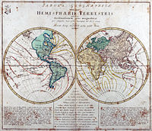
Leonhard Euler
Miscellaneous
  Geography
  Stereographic projection

Slide 11


Leonhard Euler
Miscellaneous
  Euler’s family life
  Challenges in life
  Impact on Modern World

Slide 12
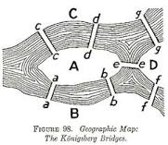
The Seven Bridge Problem
Seven Bridges of Königsberg

Slide 13
Discussion Session: Solving The Seven Bridge Problem
The idea of abstraction
  Vertices and edges
  Odd and even vertices

Slide 14
Discussion Session: Solving The Seven Bridge Problem
The idea of abstraction
  Vertices and edges
  Odd and even vertices
Graphs
  When can a graph “be fully visited without turning”?
  Simple examples
  Sufficient and Necessary Condition
Answer to the problem

Slide 15
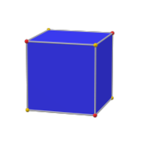

Euler’s Polyhedron Formula
What can we say about polyhedra?
Vertices+Faces-Edges=2
Why is it true?

Slide 16
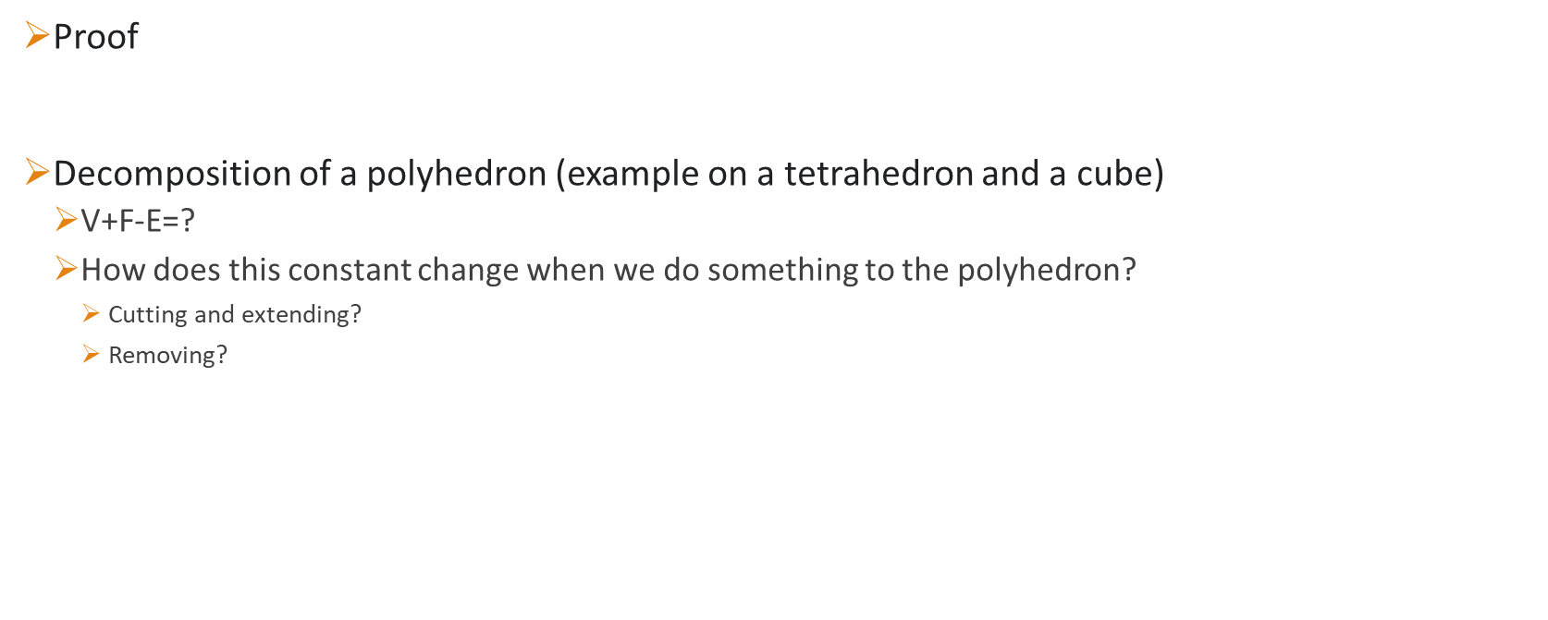
Discussion Session: Euler’s Polyhedron Formula
Proof
Decomposition of a polyhedron (example on a tetrahedron and a cube)
  $\text{V}\text{+}\text{F}\text{−}\text{E}\text{=?}$
  How does this constant change when we do something to the polyhedron?
    Cutting and extending?
    Removing?

