Slide 1
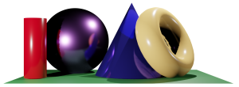
Math 035 General View of Mathematics
Hongda Qiu
Department of Mathematics
hqiu@psu.edu
402 McAllister

Slide 2


Introduction to German Mathematics
German Education
    The earliest universities in Human history
      Georg-August-Universität Göttingen, Gottingen, 1734
      Humboldt-Universität zu Berlin, Prussia, 1809

Slide 3

Introduction to German Mathematics
German Math Community in 18th century
    The dilemma
    The concentration on practical questions
    The bifurcation of pure and applied math

Slide 4
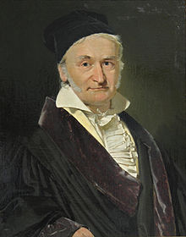

Carl Friedrich Gauss
Life (1777-1855)
Early Life
  Family
Education and early career
  University of Helmstedt
    Private Scholar under Duke of Brunswick
  University of Göttingen

Slide 5
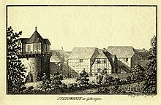
Carl Friedrich Gauss
Career
  University of Göttingen

Slide 6
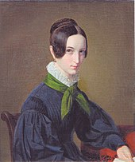
Carl Friedrich Gauss
Life
  Connection with math community
  Family
  Personality

Slide 7
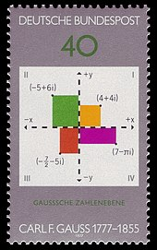
Carl Friedrich Gauss
Life
  Impact

Slide 8
Carl Friedrich Gauss
Some problems solved by Gauss
  1+2+3+…+100=?

Slide 9

Carl Friedrich Gauss
Some problems solved by Gauss
  Regular 17-gon

Slide 10
Carl Friedrich Gauss
The idea of non-Euclidean geometry
  Recall the Euclidean fifth postulate

Slide 11
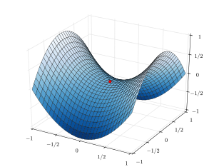

Carl Friedrich Gauss
The idea of non-Euclidean geometry

Slide 12
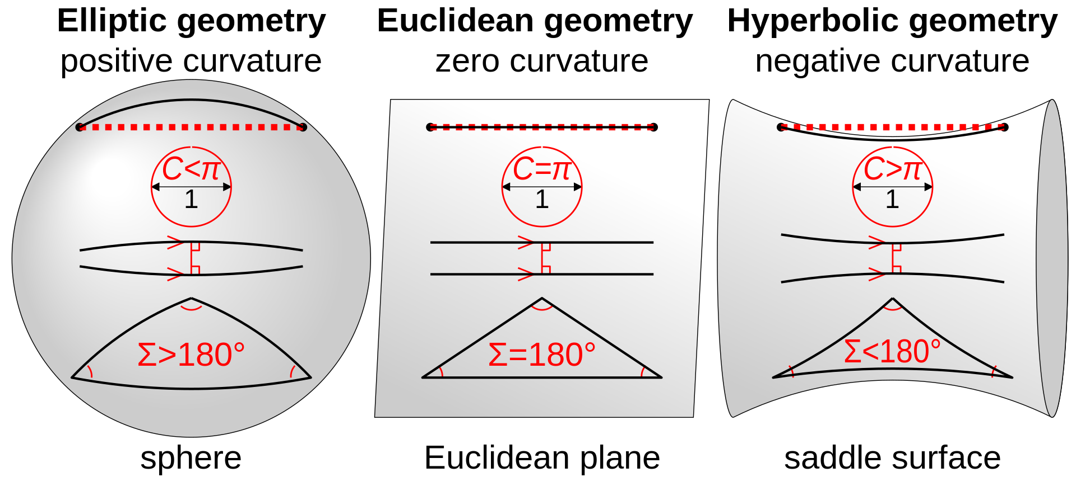
Carl Friedrich Gauss
The idea of non-Euclidean geometry

Slide 13
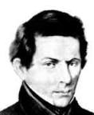
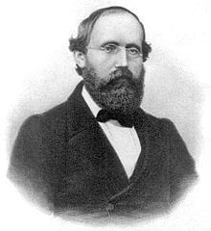
Carl Friedrich Gauss
The idea of non-Euclidean geometry
Riemann
Lobachevsky

Slide 14
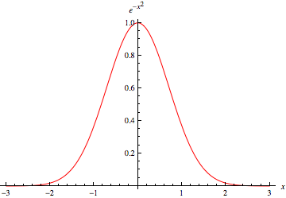
Carl Friedrich Gauss
Gaussian Distribution

Slide 15

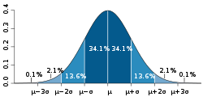
Carl Friedrich Gauss
Gaussian Distribution

Slide 16
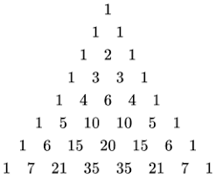
Carl Friedrich Gauss
How to obtain a Gaussian Distribution
  Pascal’s Triangle

Slide 17
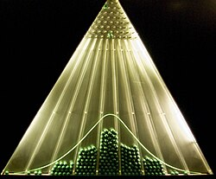
Carl Friedrich Gauss
How to obtain a Gaussian Distribution

Slide 18
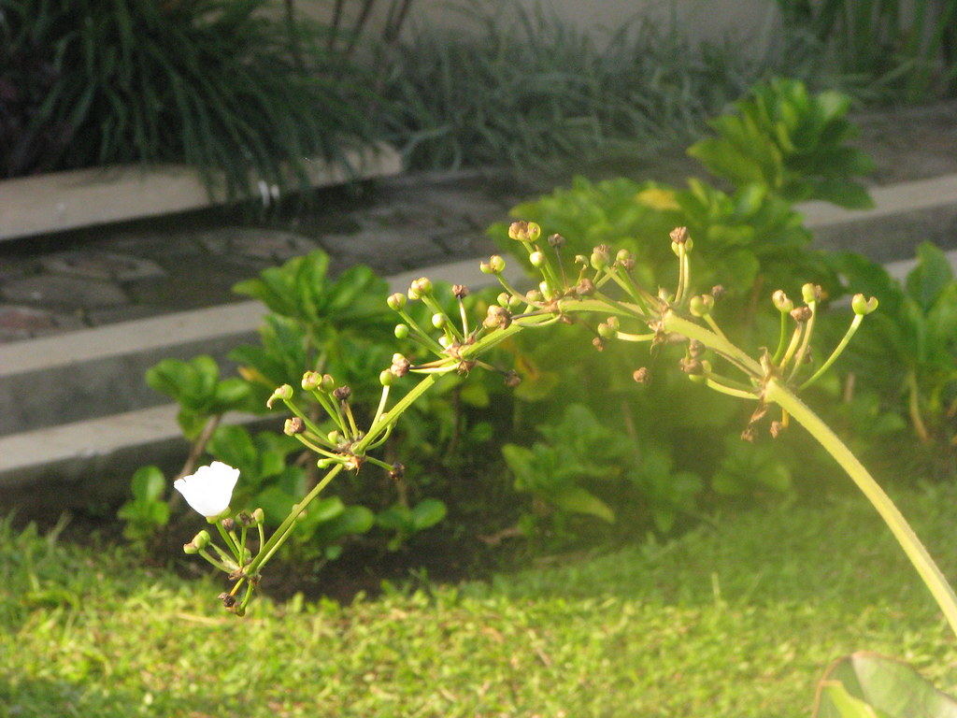
Carl Friedrich Gauss
Gaussian Distribution in nature

Slide 19

Carl Friedrich Gauss
Gaussian Distribution in nature

Slide 20
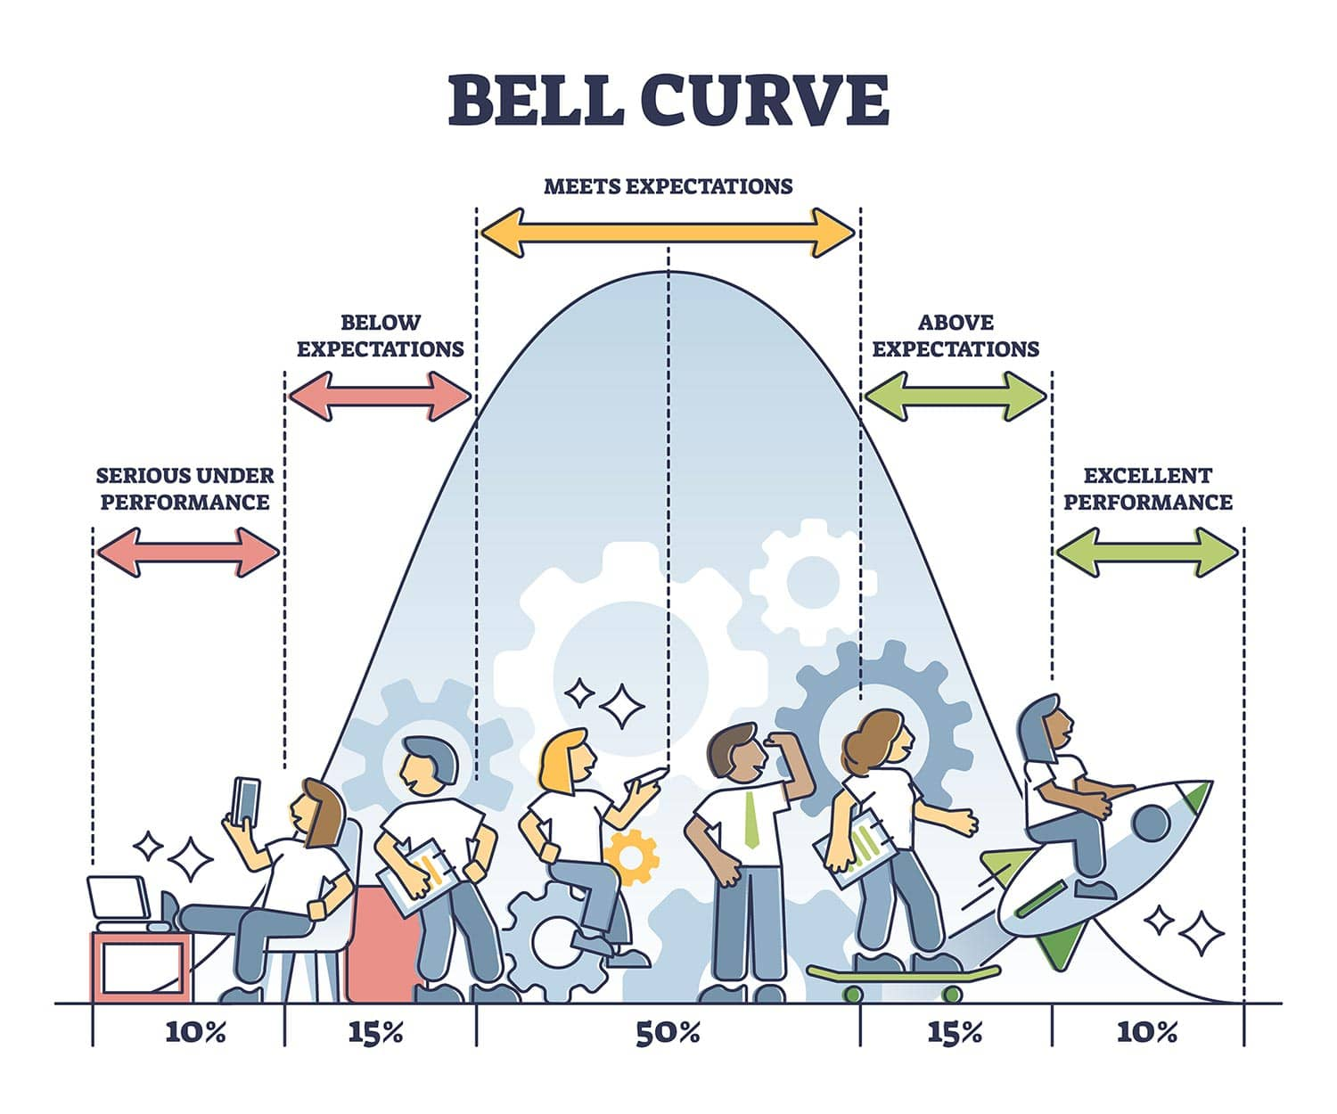
Carl Friedrich Gauss
Gaussian Distribution in nature

