Slide 1
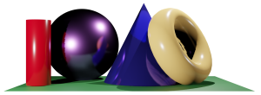
Math 035 General View of Mathematics
Hongda Qiu
Department of Mathematics
hqiu@psu.edu
402 McAllister

Slide 2
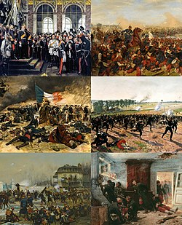
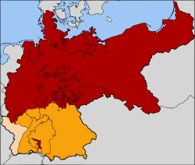
Introduction to German Mathematics
The Franco-Prussia War, 1870
  The rise of North German Confederation

Slide 3
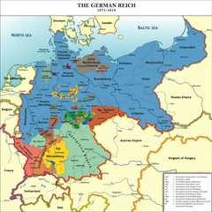
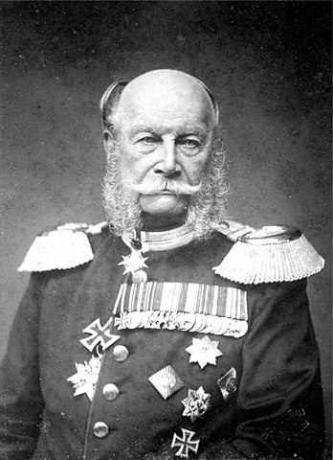

Introduction to German Mathematics
The Franco-Prussia War, 1870
The Unification of Germany, 1866-1871
  The uniting of 25 member states
  State of the German Empire

Slide 4
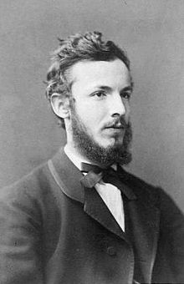
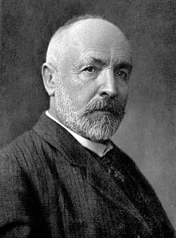
Georg Cantor
Life (1845-1918)
Early Life
  Born
  Immigration of Family
Education and early career
  Swiss Federal Polytechnic, Zurich, Switzerland
  University of Berlin

Slide 5
Georg Cantor
Career at Halle University
Set Theory, 1874 and 1884

Slide 6
Georg Cantor
The idea of “Set”
The definition of “Set”
  The Barber paradox, Russell
  Statement: Should a barber that “only do haircut for he who that never do haircut to himself” do haircut to himself?

Slide 7
Georg Cantor
The idea of “Set”
The definition of “Set”
Quick remark: Similar philosophy debation: Is the “God” omnipotent?

Slide 8
Georg Cantor
The idea of “Set”
The definition of “Set”
Quick remark: Similar philosophy debation: Is the “God” omnipotent?
  Can the God create something that he cannot raise up?

Slide 9
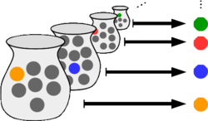
Georg Cantor
The idea of “Set”
The definition of “Set”
Axiom of Choice
  Given any collection of sets, each containing at least one element, it is possible to construct a new set by arbitrarily choosing one element from each set (even if the collection is infinite).

Slide 10
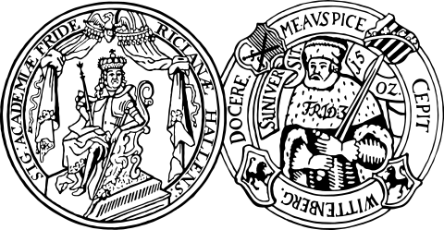
Georg Cantor
Career at Halle University
Controversy of Set Theory and Criticism on Cantor’s work
  Affection to his career

Slide 11
Georg Cantor
Connection to the German Mathematical Society
Late Life

Slide 12
Georg Cantor
The idea of “Infinity”
Infinitely large and infinitely small

Slide 13
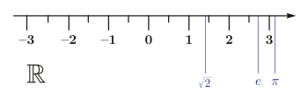
Georg Cantor
Are all infinity the same?
Which of the following have larger population, the rationals or the real numbers?

Slide 14
Georg Cantor
Are all infinity the same?
Which of the following have larger population, the rationals or the real numbers?
Before the main question: which of the following have larger population, the integers or the rationals?

Slide 15
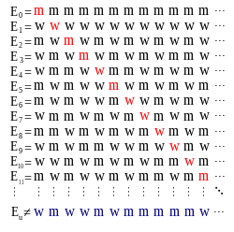
Georg Cantor
Are all infinity the same?
Which of the following have larger population, the rationals or the real numbers?
Cantor’s diagonal argument
  The concept of “countablility”

Slide 16
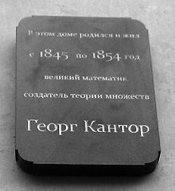
Georg Cantor
Late Life
Impact of Cantor

