Slide 1
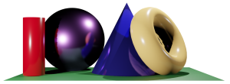
Math 035 General View of Mathematics
Hongda Qiu
Department of Mathematics
hqiu@psu.edu
402 McAllister

Slide 2
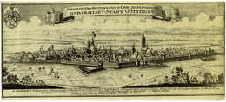
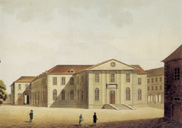

Introduction to German Mathematics
The Rise of Göttingen School
Origin

Slide 3
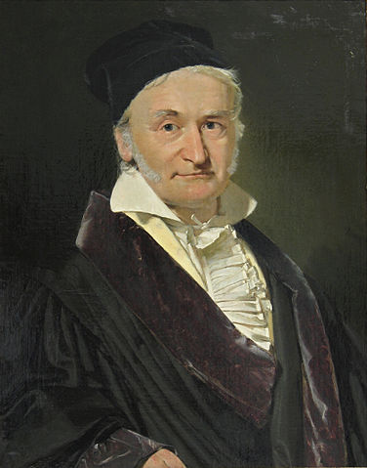
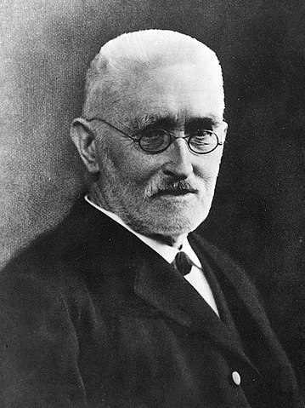
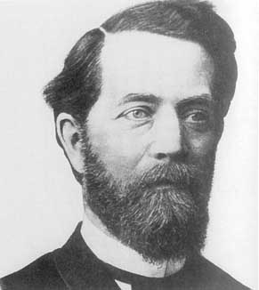
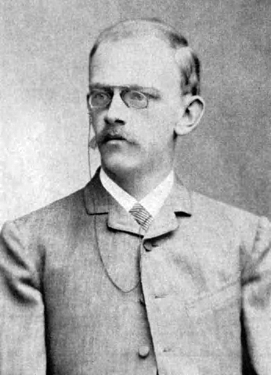
Introduction to German Mathematics
The Rise of Göttingen School
The custom started by Klein—”Youth first”
Erlanger Programm, 1872
Hilbert’s 23 Questions, 1900
Gauss
Dedkind
Klein
Hilbert

Slide 4
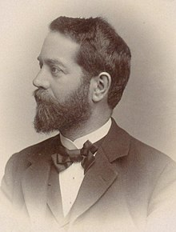
Felix Klein
Life (1849-1925)
Early Life
Düsseldorf, Prussia
Education and early career
University of Bonn, 1865-1868
Service in Prussian Army, 1870-1871
Professor, University of Erlangen-Nuremburg, 1872
Leaving

Slide 5
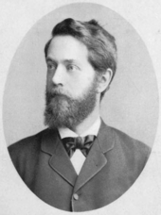
Felix Klein
Life (1849-1925)
Career
Professor, Technische Hochschule München, 1875
Chair of Geometry, Leipzig, 1880
Professor, University of Göttingen, 1886

Slide 6
Felix Klein
At Gottingen
Construction on the Department of Mathematics
Seminar
Library
Mathematische Annalen
The peer reviewing system

Slide 7
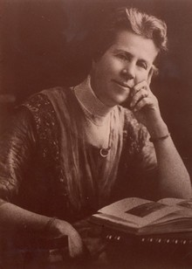
Felix Klein
At Gottingen
The Start of Women Admission, 1893
The first mathematical Ph.D. thesis by woman
President of the International Commission on Mathematical Instruction at the Rome International Congress of Mathematicians
Grace Young

Slide 8
Felix Klein
Impact on University of Gottingen
The Gottingen School
Impact on Elementary Mathematical Education
Training of mathematical teachers

Slide 9
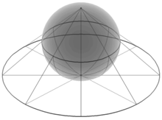
Felix Klein
Erlanger Programm
Vergleichende Betrachtungen über neuere geometrische Forschungen
Riemannian Geometry
Projective Geometry
Group Theory

Slide 10
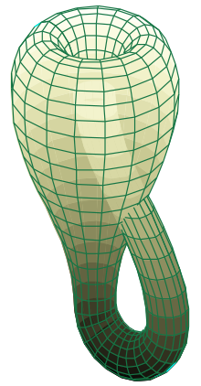
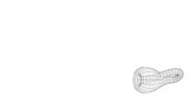
Felix Klein
Klein Bottle
A 3-dimensional item that cannot exist in 3-dimensional space

Slide 11
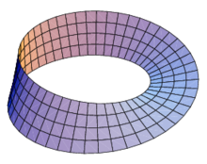
Felix Klein
Klein Bottle
A 3-dimensional item that cannot exist in 3-dimensional space
Related item: Mobius Belt
A 2-dimensional item that cannot exist in 2-dimensional space

Slide 12
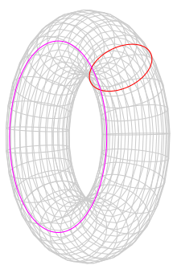
Felix Klein
Klein Bottle
Related item: Torus

Slide 13
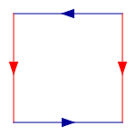
Felix Klein
Klein Bottle
Gluing
Torus
Klein Bottle

Slide 14
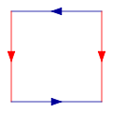





Felix Klein
Klein Bottle
Gluing
Torus
Klein Bottle

Slide 15
Felix Klein
Remarks

