Slide 1

Math 035 General View of Mathematics
Hongda Qiu
Department of Mathematics
hqiu@psu.edu
402 McAllister

Slide 2
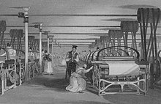
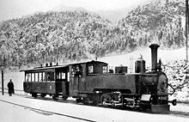
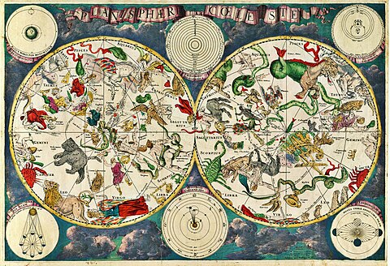
Introduction to European Mathematics
The Flourish of Science and Engineering during the 1st and 2nd Industrial Revolution
  Public transportation
  Astronomy and Naval Science
  Physics
  Chemistry

Slide 3
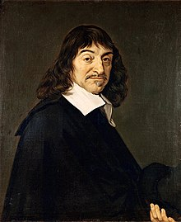
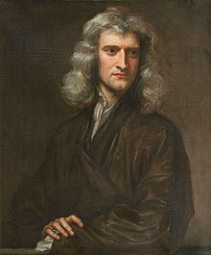
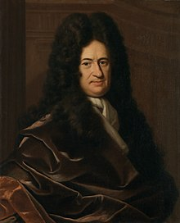
Introduction to European Mathematics
The theoretical support for everything
  Natural Philosophy
Three key figures
Descartes
Newton
Leibniz

Slide 4
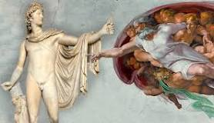
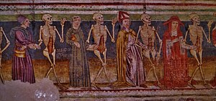
Introduction to European Mathematics
A quick “flash back”
Renaissance, 15th-16th
  The origin of Humanism
The Reformation, early 1500s-early 1600s
  The start of Protestantism

Slide 5
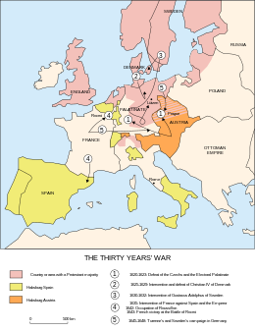
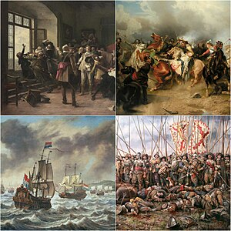
Introduction to European Mathematics
The Thirty Years’ War, 1618-1648
  1618-1635
  1635-1648
The Peace of Westphalia
  Early International Community

Slide 6

Gottfried Wilhelm Leibniz
Life (1646-1716)
Early Life
  Family Impact
  At his library
Education Experience
  Leipzig University
  Habilitation (Doctor in Law), University of Altdorf

Slide 7
Gottfried Wilhelm Leibniz
At Nuremburg
  Alchemist
  Serving for the Elector
At Paris, 1672-1676
  Political activities
  Acquaintance with Huygens

Slide 8
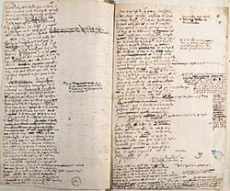
Gottfried Wilhelm Leibniz
At Hanover
  Librarian
  Acquaintance with Peter the Great, 1711

Slide 9
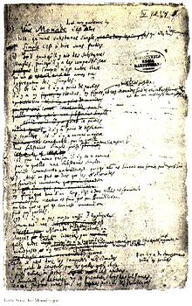
Gottfried Wilhelm Leibniz
Historical Impacts--the Last General Genius
Monads

Slide 10
Gottfried Wilhelm Leibniz
Optimism
The language of Symbolic thought
Logics

Slide 11
Gottfried Wilhelm Leibniz
Modern Mathematical Language

Slide 12
Gottfried Wilhelm Leibniz
The idea of Calculus
  Recall: Cartesian coordinate system
  Differentiation
  Integral

Slide 13
Gottfried Wilhelm Leibniz
The idea of Calculus
  Example from Physics and Engineering

Slide 14
Gottfried Wilhelm Leibniz
Remarks about Calculus
  Historical dispution

