Slide 1

Math 035 General View of Mathematics
Hongda Qiu
Department of Mathematics
hqiu@psu.edu
402 McAllister

Slide 2
Introduction to German Mathematics
Some further notes on German Mathematics
  Equality of Education—the social impact of development of mathematics
  The custom started by Klein—”Youth first”
  The disruption by War I and War II

Slide 3
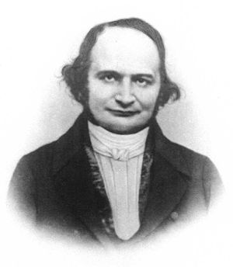
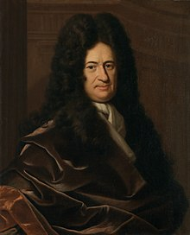
Introduction to German Mathematics
Some other important figures in German Mathematics
  The “Jacobis”
  Hilbert
  Minkovski
  Weyl
Leibniz
Carl Jacobi

Slide 4
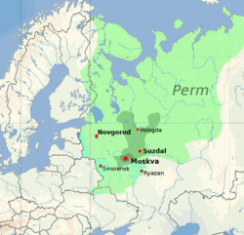

Introduction to Russian Mathematics
The origin of the Russian nation
  The great expansion of Mongolians and the origin of Principality of Moscow
  The expansion of Moscow ad the foundation of the Tsardom of Russia, 1547-1721

Slide 5
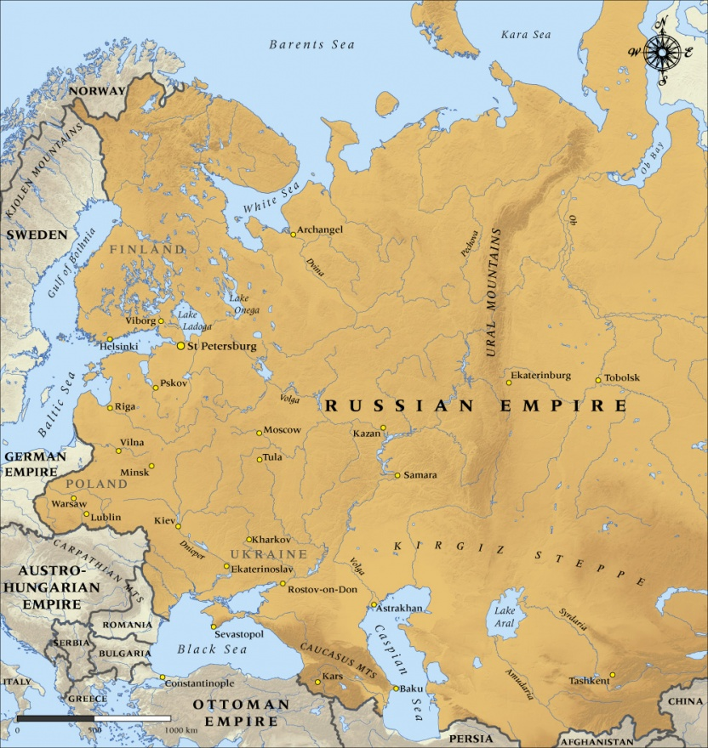

Introduction to Russian Mathematics
The Russian Empire, 1721-1914
The reform by Peter the Great
  Time before Peter the Great

Slide 6
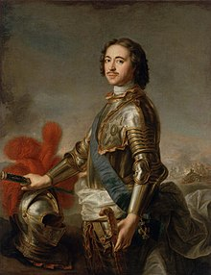
Introduction to Russian Mathematics
The reform by Peter the Great (Peter I), 1721-1725
  Time before Peter the Great
  The Grand Embassy of Peter I, 1697
  The reform of Russian Empire
  The foundation of modern Russian academic community

Slide 7
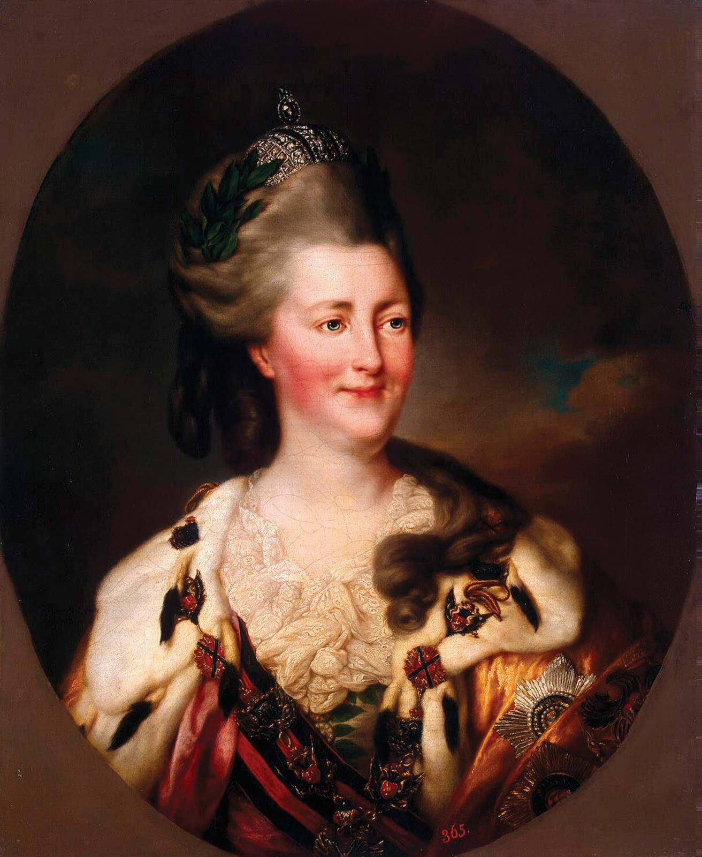
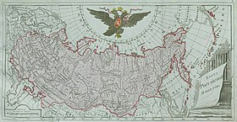
Introduction to Russian Mathematics
The Period of Katherine the Great and the development of Russian academics, 1762-1796

Slide 8
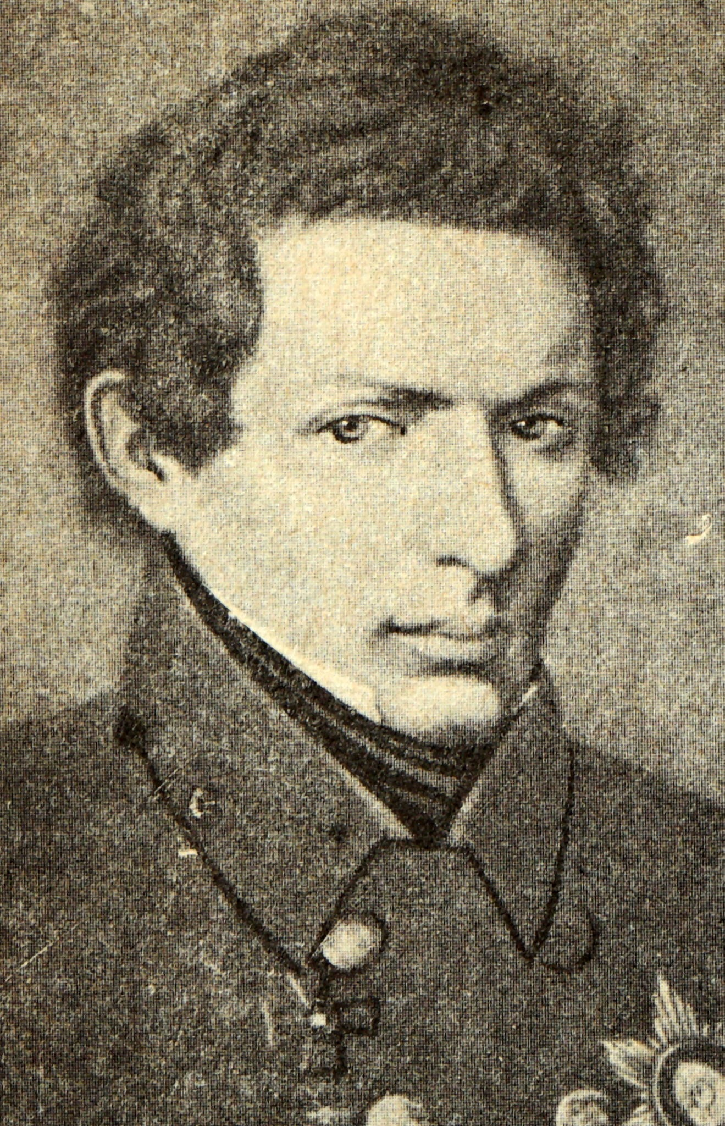

Nikolai Lobachevsky
Никола́й Ива́нович Лобаче́вский
An appetizer: The Song “Lobachevsky”, 1953
  https://www.youtube.com/watch?v=_zZ8L6TOreE

Slide 9
Nikolai Lobachevsky
The Song “Lobachevsky”, 1953
  https://www.youtube.com/watch?v=_zZ8L6TOreE
Life (1792-1856)
  Born: Novgorod

Slide 10
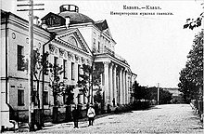
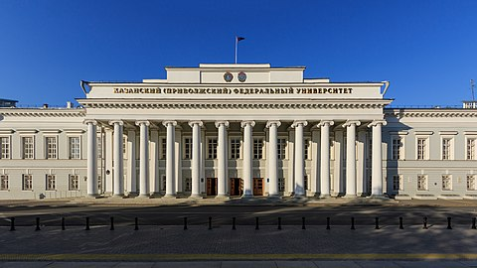

Nikolai Lobachevsky
Никола́й Ива́нович Лобаче́вский
Life (1792-1856)
  Born: Novgorod
Early Life
  Kazan Gymnasium, 1802-1807
  Kazan University, 1807-1811

Slide 11
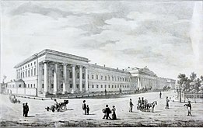
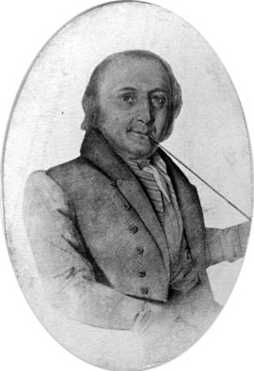
Nikolai Lobachevsky
Early career at Kazan
  Lecturer, 1814
  Associate Professor, 1816
  Professor, 1822
    Teacher in several subjects
    Supervisor
    Librarian
  Senior Official and Head of Kazan, 1827
Kazan in early 1800s
Johann Bartels

Slide 12
Nikolai Lobachevsky
Early career at Kazan
  Fighting against Cholera pandemic, 1830s
  Suspension of senior position, 1846
Kazan in early 1800s

Slide 13
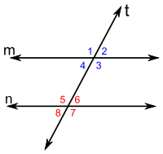
Nikolai Lobachevsky
The idea of Lobachevskian geometry (Hyperbolic geometry)
  Euler’s five postulates
  1st: To draw a straight line from any point to any point[l]
  2nd: To produce a finite straight line continuously in a straight line
  3rd: To describe a circle with any centre and distance
  4th: That all right angles are equal to one another
  5th: That, if a straight line falling on two straight lines make the
  interior angles on the same side less than two right angles,
  the two straight lines, if produced indefinitely, meet on that side
  on which are the angles less than the two right angles
  Ps: anle 1=angle 5 = angle 3= angle 5= angle 7

Slide 14
Nikolai Lobachevsky
The idea of Lobachevskian geometry (Hyperbolic geometry)
  Historical problem: can we modify the 5-th postulate and still get some conclusion?
  Equivalent statements of the 5-th postulate: triangle assumption and right-angle assumption

Slide 15
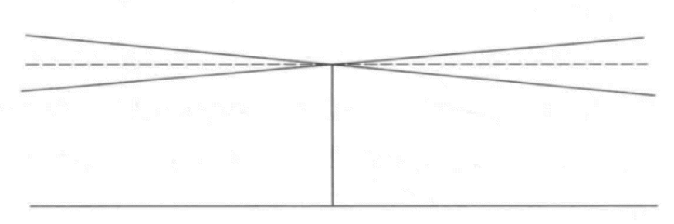
Nikolai Lobachevsky
The idea of Lobachevskian geometry (Hyperbolic geometry)
Axiom of Hyperbolic geometry: “Parallels are not unique through a point different from a certain line.”

Slide 16
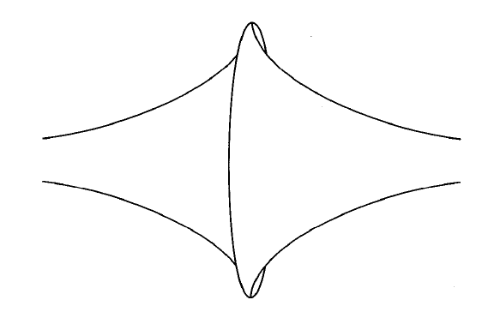
Nikolai Lobachevsky
The idea of Lobachevskian geometry (Hyperbolic geometry)
An example of hyperbolic object

Slide 17
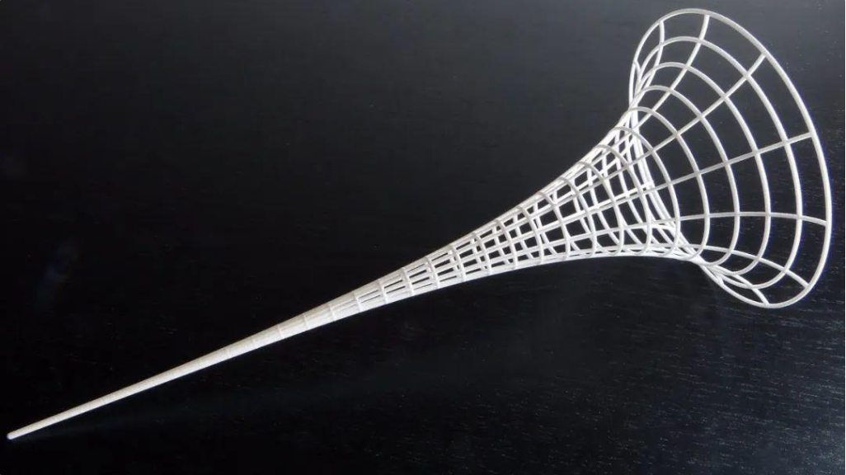
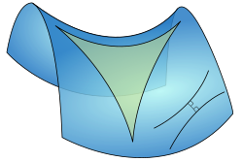
Nikolai Lobachevsky
The idea of Lobachevskian geometry (Hyperbolic geometry)
The publication of “A Concise Outline of the Foundations of Geometry”, 1829
More examples of hyperbolic object

Slide 18
Nikolai Lobachevsky
The idea of Lobachevskian geometry (Hyperbolic geometry)
Key phenomena
  Parallels

Slide 19
Nikolai Lobachevsky
The idea of Lobachevskian geometry (Hyperbolic geometry)
Key phenomena
  “Thinner” shapes

Slide 20
Nikolai Lobachevsky
The idea of Lobachevskian geometry (Hyperbolic geometry)
Demonstration
  The saddle surface: https://www.thingiverse.com/thing:717476
  The Poincare disc: https://www.geogebra.org/m/tHvDKWdC
More examples of hyperbolic object

Slide 21
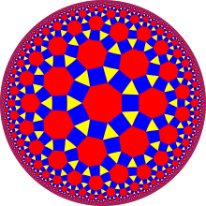
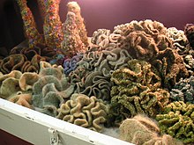
Nikolai Lobachevsky
Art, nature and Lobachevskian geometry
  Tiling: https://www.malinc.se/m/ImageTiling.php

Slide 22
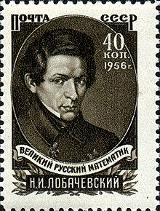
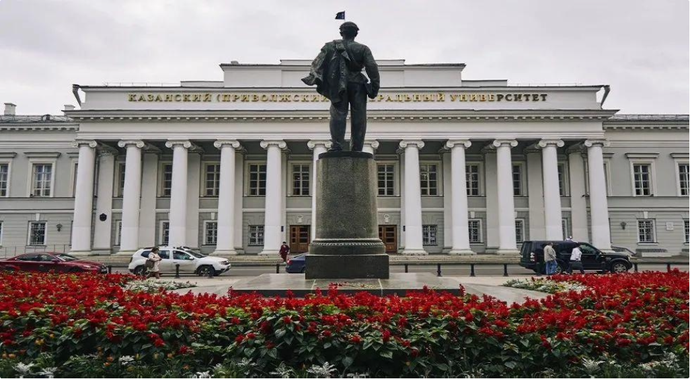
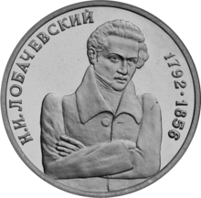
Nikolai Lobachevsky
Impact, 1840-present
Today’s Kazan

